Slide 1
#include<iostream> #include<string.h> #include<stdlib.h>
using namespace std;
class book { private:
char *author,*title,*publisher; float *price;
int *stock;
public:
book() {
author= new char[20]; title=new char[20]; publisher=new char[20]; price= new float; stock=new int;
}
void feeddata(); void editdata(); void showdata();
int search(char[],char[]); void buybook();
};
void book::feeddata() {
cin.ignore();
cout<<"\nEnter Author Name: ";
cin.getline(author,20);
cout<<"Enter Title Name: "; cin.getline(title,20); cout<<"Enter Publisher Name: "; cin.getline(publisher,20); cout<<"Enter Price: "; cin>>*price;
cout<<"Enter Stock Position: "; cin>>*stock;
}
void book::editdata() {
cout<<"\nEnter Author Name: ";
cin.getline(author,20);
cout<<"Enter Title Name: "; cin.getline(title,20); cout<<"Enter Publisher Name: "; cin.getline(publisher,20); cout<<"Enter Price: "; cin>>*price;
cout<<"Enter Stock Position: "; cin>>*stock;
}
void book::showdata() {
cout<<"\nAuthor Name: "<<author; cout<<"\nTitle Name: "<<title; cout<<"\nPublisher Name: "<<publisher; cout<<"\nPrice: "<<*price; cout<<"\nStock Position: "<<*stock;
}

Slide 2
int book::search(char tbuy[20],char abuy[20] ) { if(strcmp(tbuy,title)==0 && strcmp(abuy,author)==0)
return 1;
else return 0;
}
void book::buybook() { int count;
cout<<"\nEnter Number Of Books to buy: "; cin>>count;
if(count<=*stock) {
*stock=*stock-count;
cout<<"\nBooks Bought Sucessfully"; cout<<"\nAmount: $"<<(*price)*count;
}
else
cout<<"\nRequired Copies not in Stock";
}
int main()
{
book *B[20];
int i=0,r,t,choice;
char titlebuy[20],authorbuy[20]; while(1){
cout<<"\n\n======Book Shop Management System======"
<<"\n1. Entry of New Book"
<<"\n2. Buy Book"
<<"\n3. Search For Book"
<<"\n4. Edit Details Of Book"
<<"\n5. Exit"
<<"\n\nEnter your Choice: "; cin>>choice;
switch(choice) {
case 1: B[i] = new book;
B[i]->feeddata(); i++; break;
case 2: cin.ignore();
cout<<"\nEnter Title Of Book: "; cin.getline(titlebuy,20); cout<<"Enter Author Of Book: "; cin.getline(authorbuy,20); for(t=0;t<i;t++) {
if(B[t]->search(titlebuy,authorbuy)) B[t]->buybook();
break;
}
{
}
if(t==1)
cout<<"\nThis Book is Not in Stock";
break;
case 3: cin.ignore();
cout<<"\nEnter Title Of Book: "; cin.getline(titlebuy,20); cout<<"Enter Author Of Book: "; cin.getline(authorbuy,20);

Slide 3
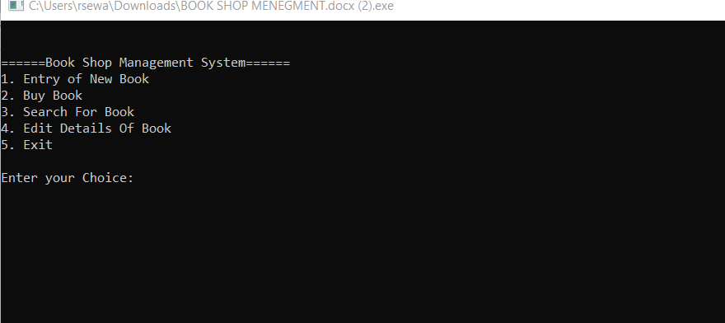
for(t=0;t<i;t++) {
if(B[t]->search(titlebuy,authorbuy))
{
cout<<"\nBook Found Successfully"; B[t]->showdata();
break;
}
}
if(t==i)
cout<<"\nThis Book is Not in Stock"; break;
case 4: cin.ignore();
cout<<"\nEnter Title Of Book: "; cin.getline(titlebuy,20); cout<<"Enter Author Of Book: "; cin.getline(authorbuy,20);
for(t=0;t<i;t++) {
if(B[t]->search(titlebuy,authorbuy))
{
cout<<"\nBook Found Successfully"; B[t]->editdata();
break;
}
}
if(t==i)
cout<<"\nThis Book is Not in Stock"; break;
case 5: exit(0);
default: cout<<"\nInvalid Choice Entered";
}
}
return 0;
}

